Slide 1
Chapter 6
User Interface Design

Slide 2
User interface
System users often judge a system by its interface rather than its functionality
A poorly designed interface can cause a user to make catastrophic errors
Poor user interface design is the reason why so many software systems are never used

Slide 3
User interface design
Designing graphical interfaces for software systems
The interface design elements for software tell how information flows into and out of the system and how it is communicated among the components defined as part of the architecture

Slide 4
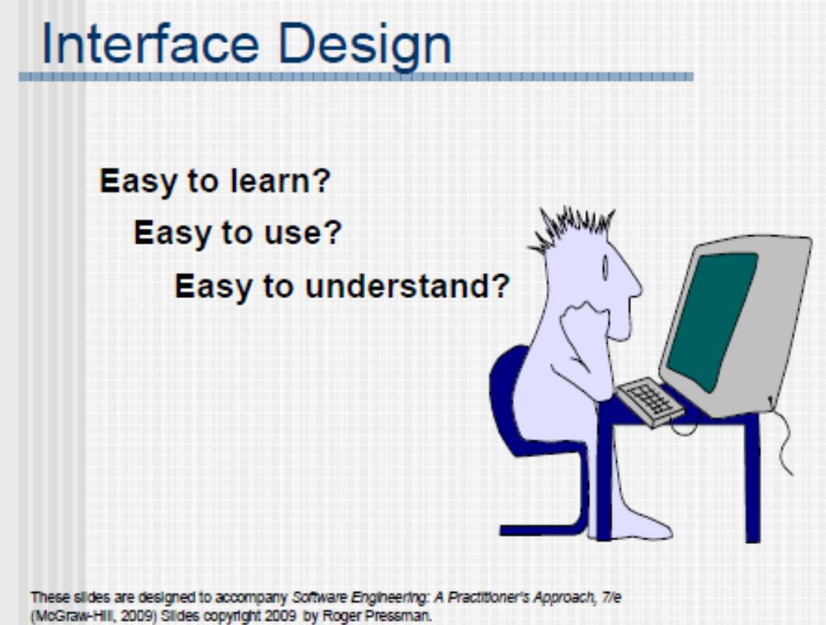

Slide 5
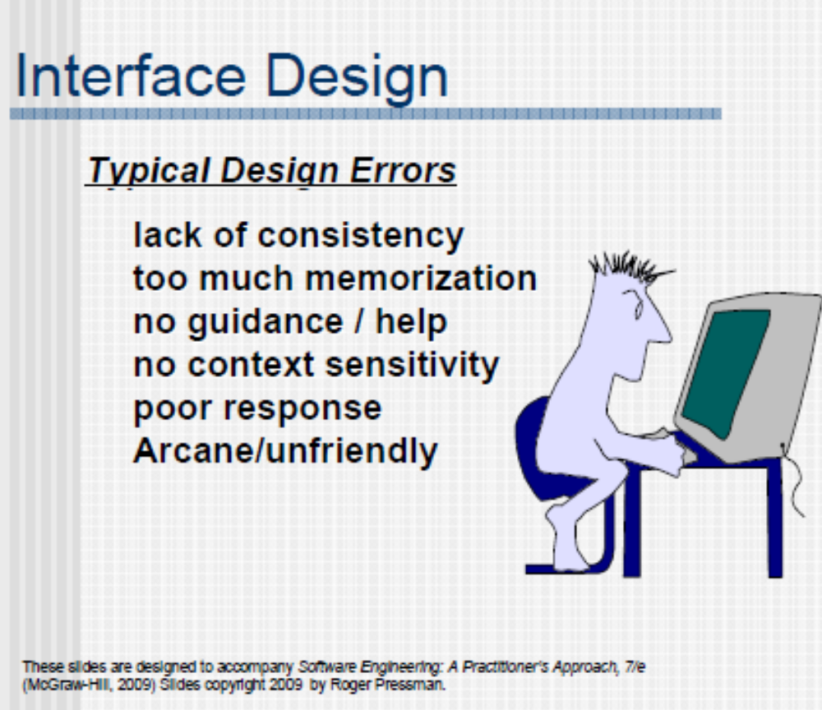

Slide 6
Golden Rules
Place the user in control
  “What I really would like is a system that reads my mind. It knows what I want to do before I need to do it and makes it very easy for me to get it done. That’s all, just that.”
Reduce the user’s memory load
  The more a user has to remember, the more error-prone interaction with the system will be
  The system should ‘remember’
Make the interface consistent

Slide 7
Place the User in Control
Define interaction modes in a way that does not force a user into unnecessary or undesired actions.
Provide for flexible interaction.((users have varying preferences) )
Allow user interaction to be interruptible and undoable.
Streamline interaction as skill levels advance and allow the interaction to be customized.
Hide technical internals from the casual user.
Design for direct interaction with objects that appear on the screen.

Slide 8
Reduce the User’s Memory Load
Reduce demand on short-term memory. (exp. providing visual cues)
Establish meaningful defaults. (“reset” option should be available)
Define shortcuts that are intuitive (easy to remember).
The visual layout of the interface should be based on a real world metaphor.
Disclose information in a progressive fashion.

Slide 9
Make the Interface Consistent
Allow the user to put the current task into a meaningful context.
Maintain consistency across a family of applications.
If past interactive models have created user expectations, do not make changes unless there is a compelling reason to do so.

Slide 10
User Interface Analysis and Design
The models
  The human engineer establishes a user model
  The software engineer creates a design model
  The end-user develops a mental image or user’s mental model (system perception)
  The implementers create an implementation model
The process
  User, task, and environment analysis and modeling
  Interface design
  Interface construction
  Interface validation

Slide 11
The Models
User model
  end user profiles:
    Novice
    Knowledgeable, intermittent user,
    Knowledgeable, frequent users
Design model
  incorporates data, architectural, interface, and procedural representations of the software
User's model or system perception
  user's mental image of system
Implementation model
  look and feel of the interface and supporting media

Slide 12
The Process - User Analysis
Understand who the end-users are
What is likely to motivate and please them
How they can be grouped into different user classes or profiles
What their mental models of the system are
How the user interface must be characterized to meet their needs

Slide 13
The Process - Task Analysis and Modeling
Software engineer studies tasks human users must complete to accomplish their goal in the real world without the computer and map these into a similar set of tasks that are to be implemented in the context of the user interface
Software engineer studies existing specification for computer-based solution and derives a set of tasks that will accommodate the user model, design model, and system perception
Software engineer may devise an object-oriented approach by observing the objects and actions the user makes use of in the real world and model the interface objects after their real world counterparts
→ Know the user, know the tasks

Slide 14
The Process - Analysis of Display Content
Type of content
  Character-based reports
  Graphical displays
  Specialized information
Source of content
  Generated by components
  Acquired from data store
  Transmitted from systems external

Slide 15
The Process - Interface Design Activities
Establish the goals and intentions of each task
Map each goal/intention to a sequence of specific actions
Specify the action sequence of tasks and subtasks (user scenario)
Indicate the state of the system at the time the user scenario is performed
Define control mechanisms → object and action
Show how control mechanisms affect the state of the system
Indicate how the user interprets the state of the system from information provided through the interface

Slide 16
Task Analysis and Modeling
Answers the following questions …
  What work will the user perform in specific circumstances?
  What tasks and subtasks will be performed as the user does the work?
  What specific problem domain objects will the user manipulate as work is performed?
  What is the sequence of work tasks—the workflow?
  What is the hierarchy of tasks?
Use-cases define basic interaction
Task elaboration refines interactive tasks
Object elaboration identifies interface objects (classes)
Workflow analysis defines how a work process is completed when several people (and roles) are involved

Slide 17
Analysis of Display Content
Are different types of data assigned to consistent geographic locations on the screen (e.g., photos always appear in the upper right-hand corner)?
Can the user customize the screen location for content?
Is proper on-screen identification assigned to all content?
If a large report is to be presented, how should it be partitioned for ease of understanding?
Will mechanisms be available for moving directly to summary information for large collections of data.
Will graphical output be scaled to fit within the bounds of the display device that is used?
How will color to be used to enhance understanding?
How will error messages and warning be presented to the user?

Slide 18
Interface Design Steps
Using information developed during interface analysis, define interface objects and actions (operations).
Define events (user actions) that will cause the state of the user interface to change. Model this behavior.
Depict each interface state as it will actually look to the end-user.
Indicate how the user interprets the state of the system from information provided through the interface.

Slide 19
Design Issues
Response time
Help facilities
Error handling
Menu and command labelling
Application accessibility
Internationalization
Notes:
System response time
time between the point at which user initiates some control action and the time when the system responds
User help facilities
integrated, context sensitive help versus add-on help
Error information handling
messages should be non-judgmental, describe problem precisely, and suggest valid solutions
Command labeling
based on user vocabulary, simple grammar, and have consistent rules for abbreviation

Slide 20
Interface Design Principles-I
Anticipation—A WebApp should be designed so that it anticipates the use’s next move.
Communication—The interface should communicate the status of any activity initiated by the user
Consistency—The use of navigation controls, menus, icons, and aesthetics (e.g., color, shape, layout)
Controlled autonomy—The interface should facilitate user movement throughout the WebApp, but it should do so in a manner that enforces navigation conventions that have been established for the application.
Efficiency—The design of the WebApp and its interface should optimize the user’s work efficiency, not the efficiency of the Web engineer who designs and builds it or the client-server environment that executes it.

Slide 21
Interface Design Principles-II
Focus—The WebApp interface (and the content it presents) should stay focused on the user task(s) at hand.
Fitt’s Law—“The time to acquire a target is a function of the distance to and size of the target.”
Human interface objects—A vast library of reusable human interface objects has been developed for WebApps.
Latency reduction—The WebApp should use multi-tasking in a way that lets the user proceed with work as if the operation has been completed.
Learnability— A WebApp interface should be designed to minimize learning time, and once learned, to minimize relearning required when the WebApp is revisited.

Slide 22
Interface Design Principles-III
Maintain work product integrity—A work product (e.g., a form completed by the user, a user specified list) must be automatically saved so that it will not be lost if an error occurs.
Readability—All information presented through the interface should be readable by young and old.
Track state—When appropriate, the state of the user interaction should be tracked and stored so that a user can logoff and return later to pick up where she left off.
Visible navigation—A well-designed WebApp interface provides “the illusion that users are in the same place, with the work brought to them.”

Slide 23
Aesthetic Design
Don’t be afraid of white space.
Emphasize content.
Organize layout elements from top-left to bottom right.
Group navigation, content, and function geographically within the page.
Don’t extend your real estate with the scrolling bar.
Consider resolution and browser window size when designing layout.

Slide 24
Graphical user interfaces
Most users of business systems interact with these systems through graphical interfaces although, in some cases, legacy text-based interfaces are still used

Slide 25
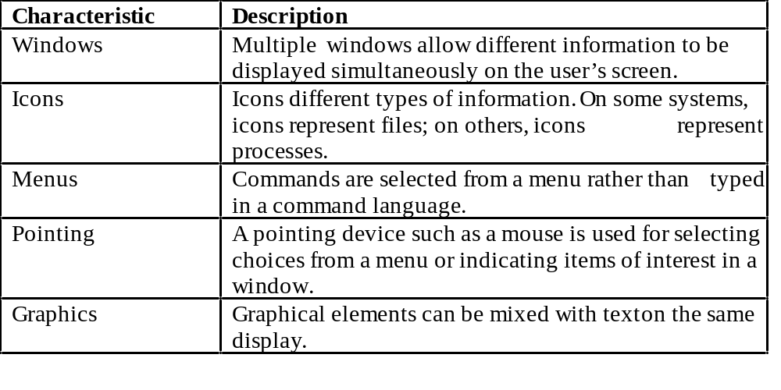
GUI characteristics

Slide 26
GUI advantages
They are easy to learn and use.
  Users without experience can learn to use the system
  quickly.
The user may switch quickly from one task to
another and can interact with several different applications.
  Information remains visible in its own window when
  attention is switched.
Fast, full-screen interaction is possible with immediate access to anywhere on the screen

Slide 27
User-centred design
The aim of this chapter is to sensitise software engineers to key issues underlying the design rather than the implementation of user interfaces
User-centred design is an approach to UI design where the needs of the user are paramount and where the user is involved in the design process
UI design always involves the development of prototype interfaces

Slide 28
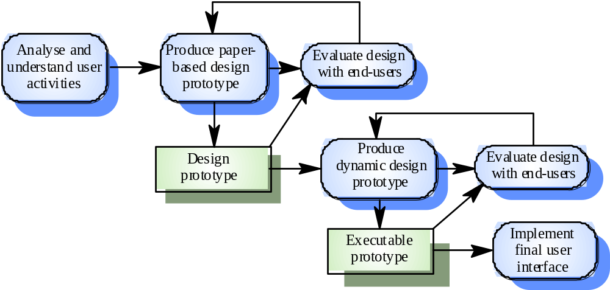
User interface design process

Slide 29
UI design principles
UI design must take account of the needs, experience and capabilities of the system users
Designers should be aware of people’s physical and mental limitations (e.g. limited short-term memory) and should recognise that people make mistakes
UI design principles underlie interface designs although not all principles are applicable to all designs

Slide 30
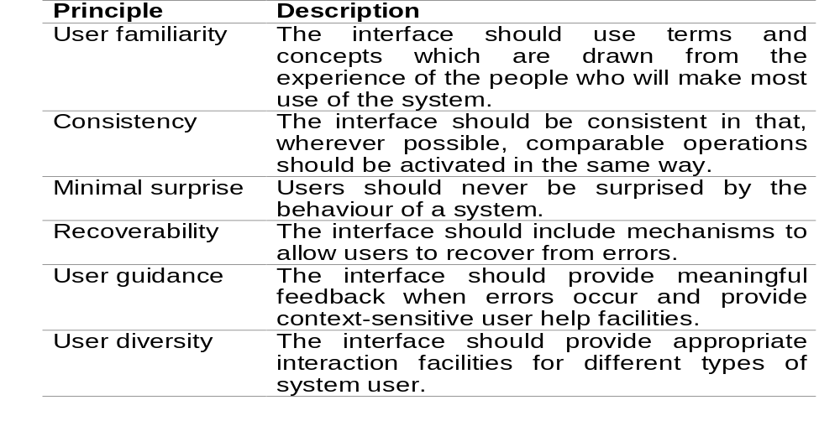
User interface design principles

Slide 31
Design principles
User familiarity
  The interface should be based on user-oriented
  terms and concepts rather than computer concepts. For example, an office system should use concepts such as letters, documents, folders etc. rather than directories, file identifiers, etc.
Consistency
  The system should display an appropriate level
  of consistency. Commands and menus should have the same format, command punctuation should be similar, etc.
Minimal surprise
  If a command operates in a known way, the user should be
  able to predict the operation of comparable commands

Slide 32
Design principles
Recoverability
  The system should provide some resilience to
  user errors and allow the user to recover from errors. This might include an undo facility, confirmation of destructive actions, 'soft' deletes, etc.
User guidance
  Some user guidance such as help systems, on-line manuals, etc. should be supplied
User diversity
  Interaction facilities for different types of user should be supported. For example, some users have seeing difficulties and so larger text should be available

Slide 33
User-system interaction
Two problems must be addressed in interactive systems design
  How should information from the user be provided to the computer system?
  How should information from the computer system be presented to the user?
User interaction and information presentation may be integrated through a coherent framework such as a user interface metaphor

Slide 34
Interaction styles
Direct manipulation
Menu selection
Form fill-in
Command language
Natural language

Slide 35
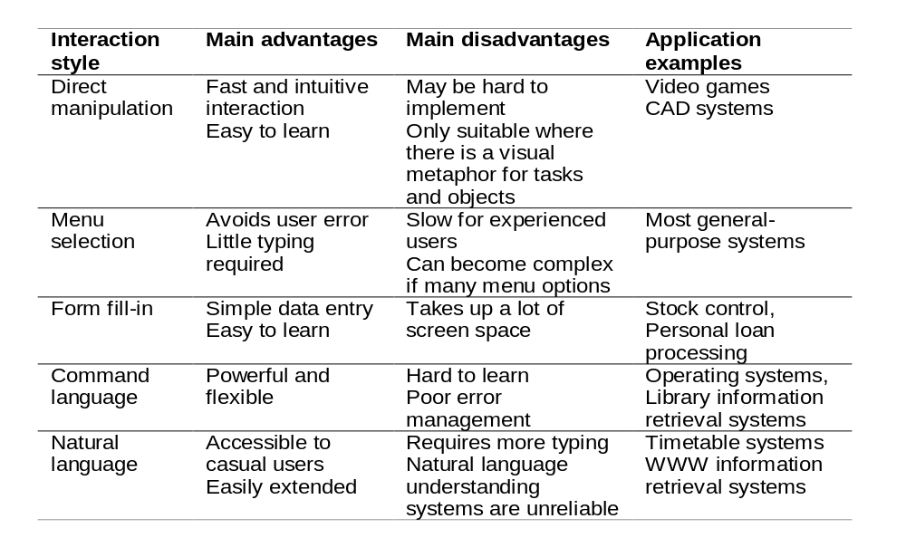
Advantages and disadvantages

Slide 36
Direct manipulation advantages
Users feel in control of the computer and are less likely to be intimidated by it
User learning time is relatively short
Users get immediate feedback on their actions
so mistakes can be quickly detected and
corrected

Slide 37
Direct manipulation problems
The derivation of an appropriate information
space model can be very difficult
Given that users have a large information
space, what facilities for navigating around that
space should be provided?
Direct manipulation interfaces can be complex to program and make heavy demands on the computer system

Slide 38
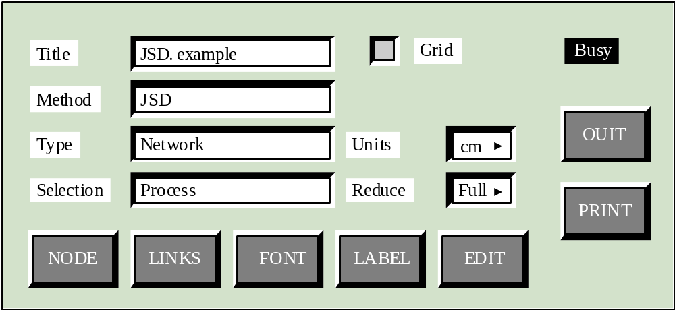
Control panel interface

Slide 39
Menu systems
Users make a selection from a list of
possibilities presented to them by the system
The selection may be made by pointing and
clicking with a mouse, using cursor keys or by
typing the name of the selection
May make use of simple-to-use terminals such as touchscreens

Slide 40
Advantages of menu systems
Users need not remember command names as they are always presented with a list of valid commands
Typing effort is minimal
User errors are trapped by the interface
Context-dependent help can be provided. The user’s context is indicated by the current menu selection

Slide 41
Problems with menu systems
Actions which involve logical conjunction (and)
or disjunction (or) are awkward to represent
Menu systems are best suited to presenting a
small number of choices. If there are many
choices, some menu structuring facility must be
used
Experienced users find menus slower than
command language

Slide 42
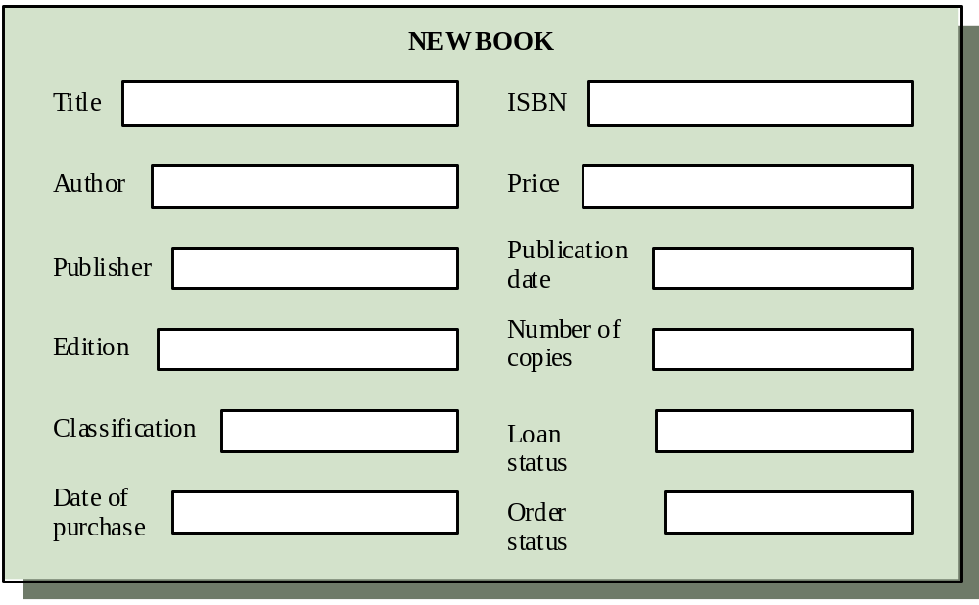
Form-based interface

Slide 43
Command interfaces
User types commands to give instructions to the system e.g. UNIX
May be implemented using cheap terminals.
Easy to process using compiler techniques
Commands of arbitrary complexity can be
created by command combination
Concise interfaces requiring minimal typing can
be created

Slide 44
Problems with command interfaces
Users have to learn and remember a command
language. Command interfaces are therefore
unsuitable for occasional users
Users make errors in command. An error
detection and recovery system is required
System interaction is through a keyboard so
typing ability is required

Slide 45
Command languages
Often preferred by experienced users because they allow for faster interaction with the system
Not suitable for casual or inexperienced users
May be provided as an alternative to menu commands (keyboard shortcuts). In some cases, a command language interface and a menu-based interface are supported at the same time

Slide 46
Natural language interfaces
The user types a command in a natural language. Generally, the vocabulary is limited and these systems are confined to specific application domains (e.g. timetable enquiries)
NL processing technology is now good enough to make these interfaces effective for casual users but experienced users find that they require too much typing

Slide 47
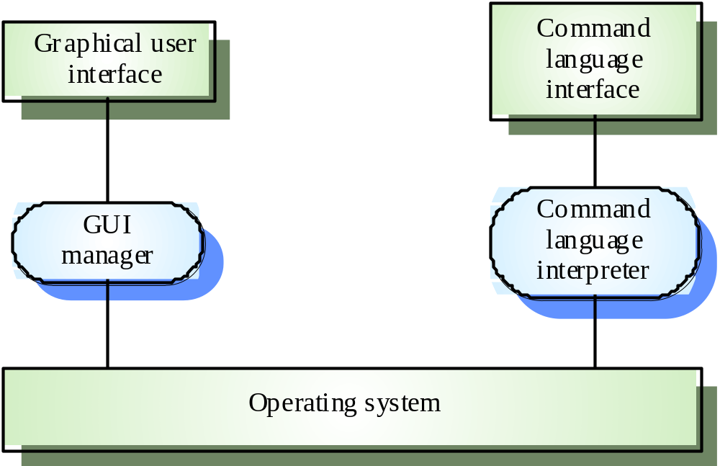
Multiple user interfaces

Slide 48
Information presentation
Information presentation is concerned with presenting system information to system users
The information may be presented directly (e.g. text in a word processor) or may be transformed in some way for presentation (e.g. in some graphical form)
The Model-View-Controller approach is a way of supporting multiple presentations of data

Slide 49
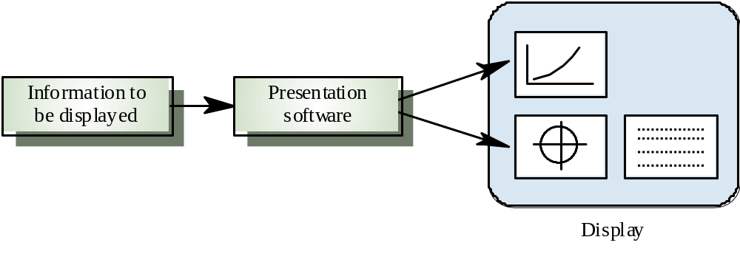
Information presentation

Slide 50
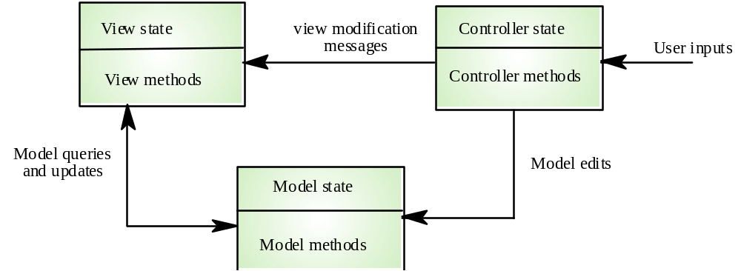
Model-view-controller

Slide 51
Information presentation
Static information
  Initialised at the beginning of a session. It does not change
  during the session
  May be either numeric or textual
Dynamic information
  Changes during a session and the changes must be
  communicated to the system user
  May be either numeric or textual

Slide 52
Information display factors
Is the user interested in precise information or
data relationships?
How quickly do information values change?
Must the change be indicated immediately?
Must the user take some action in response to
a change?
Is there a direct manipulation interface?
Is the information textual or numeric? Are relative values important?

Slide 53
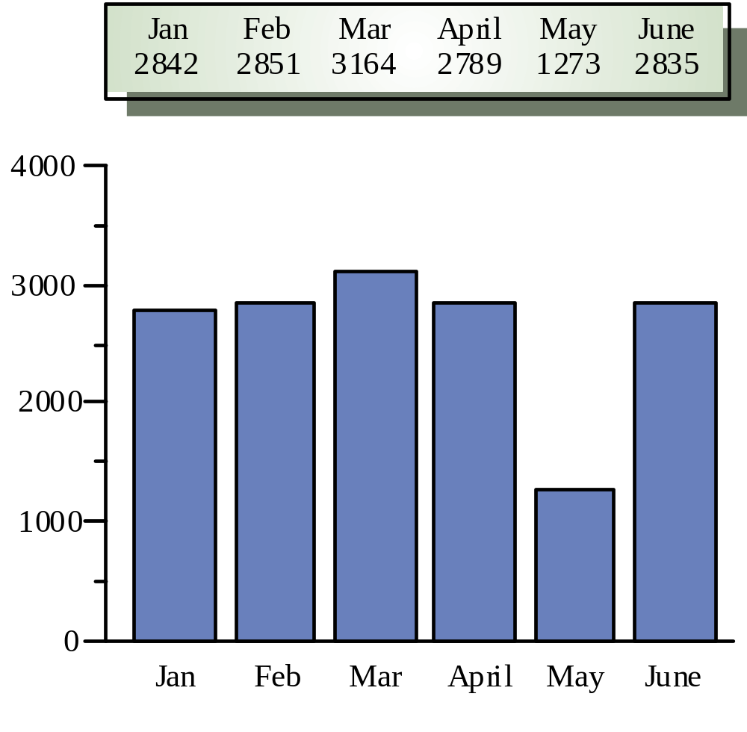
Alternative information presentations

Slide 54
Analogue vs. digital presentation
Digital presentation
  Compact - takes up little screen space
  Precise values can be communicated
Analogue presentation
  Easier to get an 'at a glance' impression of a value
  Possible to show relative values
  Easier to see exceptional data values

Slide 55
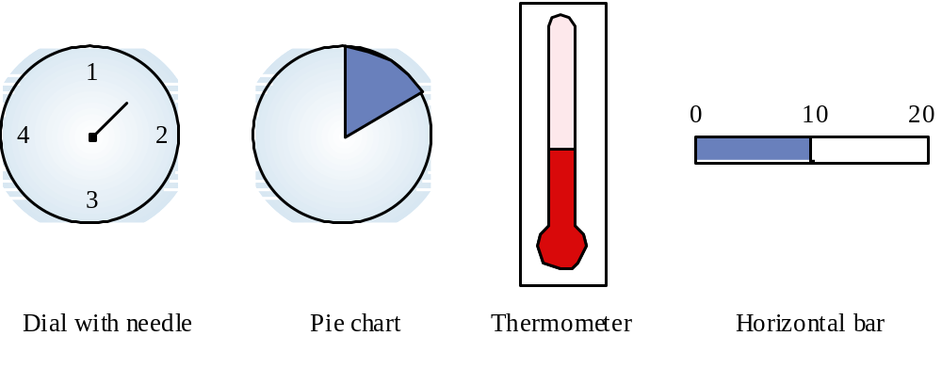
Dynamic information display

Slide 56
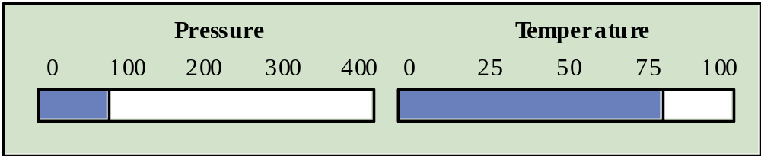
Displaying relative values

Slide 57
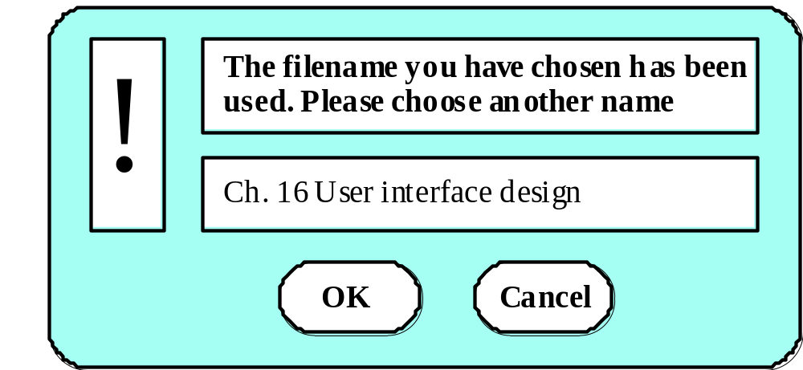
Textual highlighting

Slide 58
Data visualisation
Concerned with techniques for displaying large amounts of information
Visualisation can reveal relationships between entities and trends in the data
Possible data visualisations are:
  Weather information collected from a number of sources
  The state of a telephone network as a linked set of nodes
  Chemical plant visualised by showing pressures and temperatures in a linked set of tanks and pipes
  A model of a molecule displayed in 3 dimensions
  Web pages displayed as a hyperbolic tree

Slide 59
Colour displays
Colour adds an extra dimension to an interface
and can help the user understand complex
information structures
Can be used to highlight exceptional events
Common mistakes in the use of colour in
interface design include:
  The use of colour to communicate meaning
  Over-use of colour in the display

Slide 60
Colour use guidelines
Don't use too many colours
Use colour coding to support use tasks
Allow users to control colour coding
Design for monochrome then add colour
Use colour coding consistently
Avoid colour pairings which clash
Use colour change to show status change
Be aware that colour displays are usually lower
resolution

Slide 61
User support
User guidance covers all system facilities to support users including on-line help, error messages, manuals etc.
The user guidance system should be integrated with the user interface to help users when they need information about the system or when they make some kind of error
The help and message system should, if possible, be integrated

Slide 62
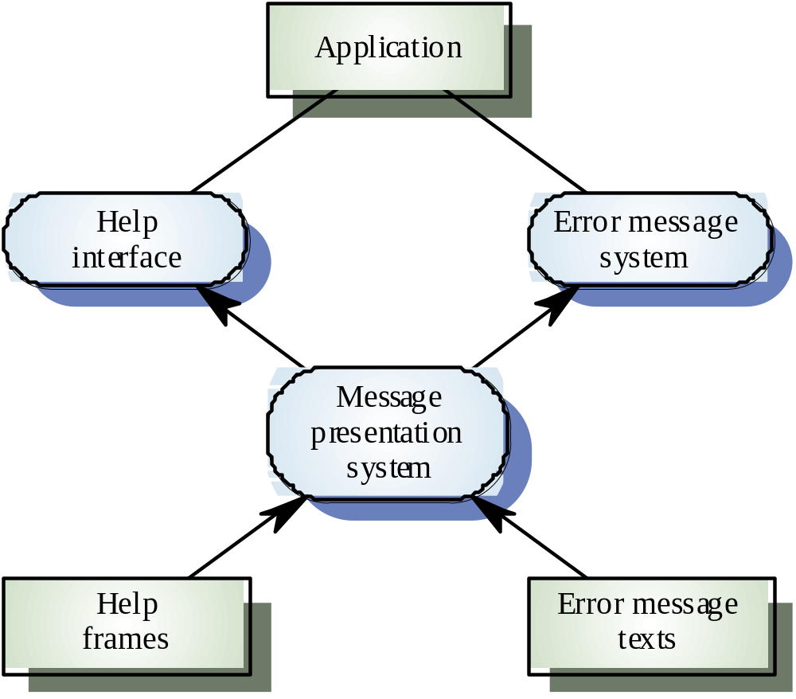
Help and message system

Slide 63
Error messages
Error message design is critically important.
Poor error messages can mean that a user
rejects rather than accepts a system
Messages should be polite, concise, consistent
and constructive
The background and experience of users
should be the determining factor in message
design

Slide 64
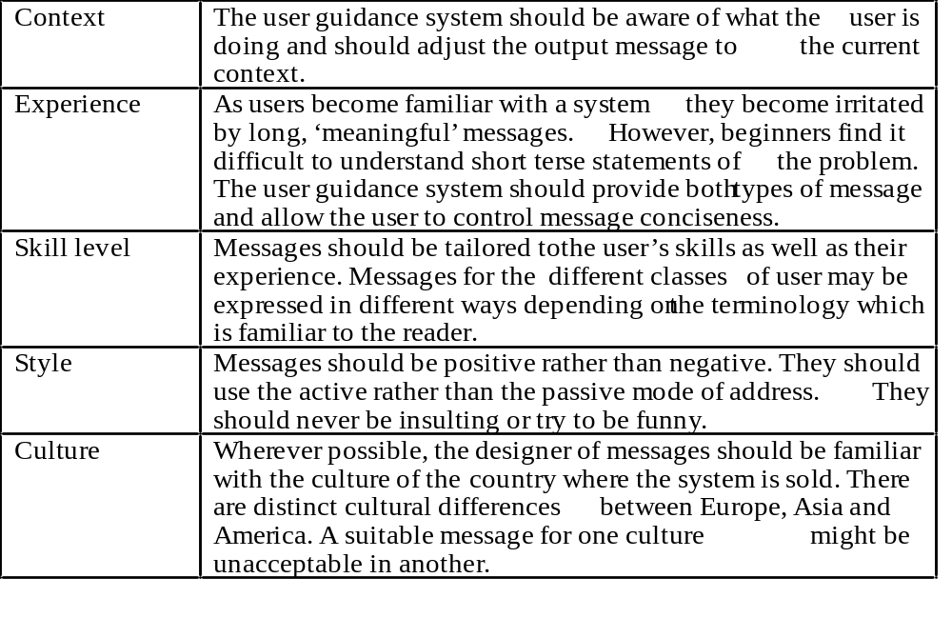
Design factors in message wording

Slide 65
Nurse input of a patient’s name
Please type the patient name in the box then click ok
Bates
, J
.
OK
Cancel

Slide 66
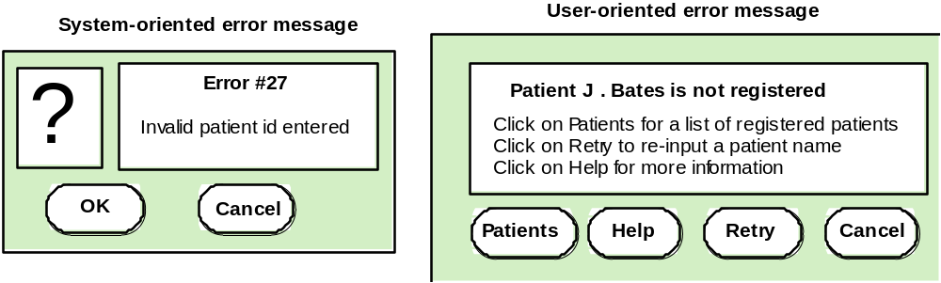
System and user-oriented error messages

Slide 67
Help system design
Help? means ‘help I want information”
Help! means “HELP. I'm in trouble”
Both of these requirements have to be taken
into account in help system design
Different facilities in the help system may be
required

Slide 68
Help information
Should not simply be an on-line manual
Screens or windows don't map well onto paper
pages.
The dynamic characteristics of the display can
improve information presentation.
People are not so good at reading screen as
they are text.

Slide 69
Help system use
Multiple entry points should be provided so that
the user can get into the help system from
different places.
Some indication of where the user is positioned
in the help system is valuable.
Facilities should be provided to allow the user
to navigate and traverse the help system.

Slide 70
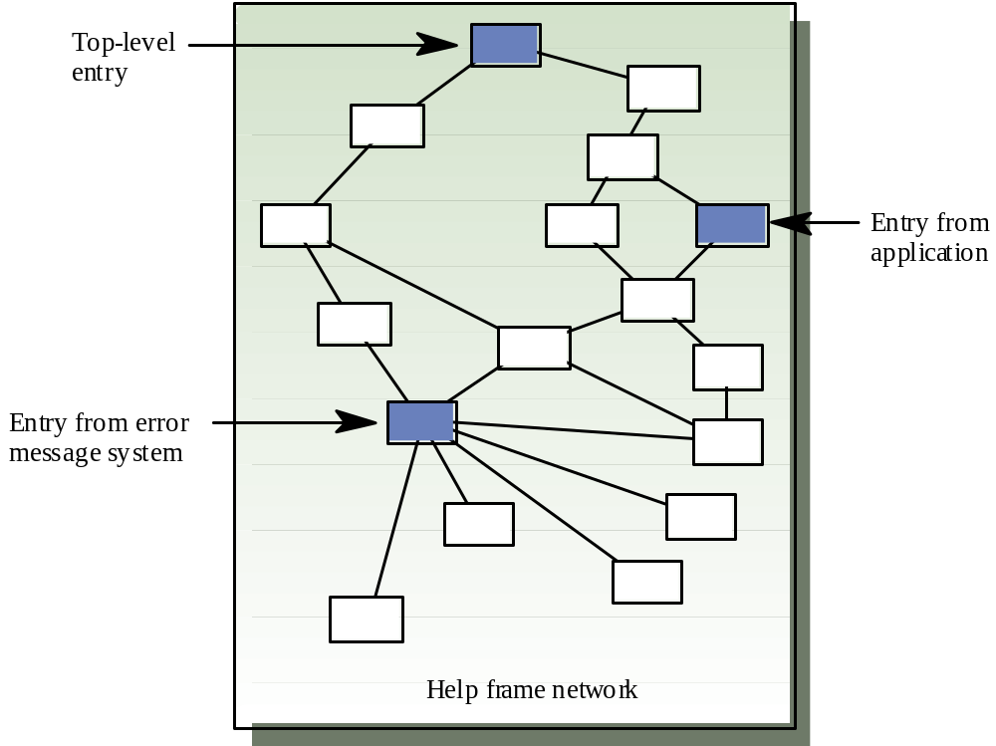
Entry points to a help system

Slide 71
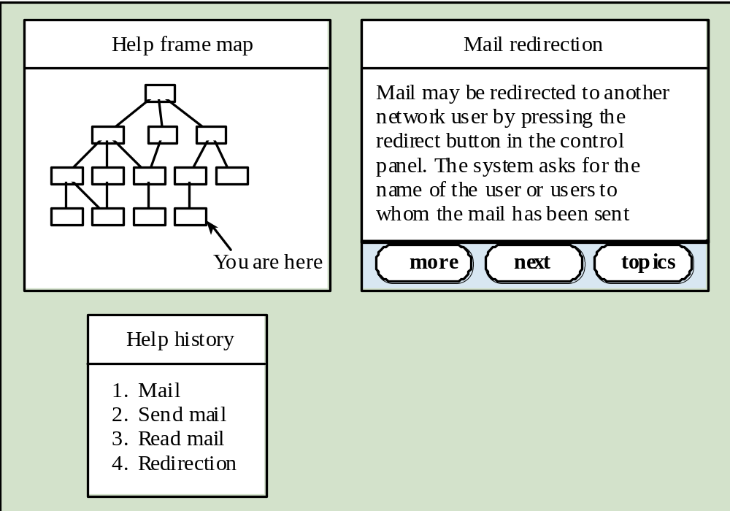
Help system windows

Slide 72
User documentation
As well as on-line information, paper documentation should be supplied with a system
Documentation should be designed for a range of users from inexperienced to experienced
As well as manuals, other easy-to-use documentation such as a quick reference card may be provided

Slide 73
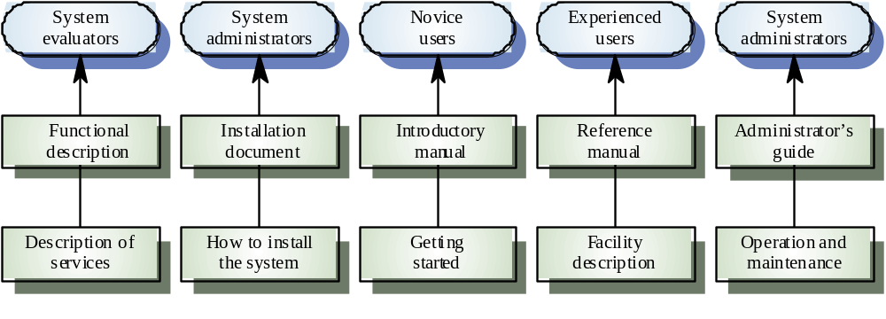
User document types

Slide 74
Document types
Functional description
  Brief description of what the system can do
Introductory manual
  Presents an informal introduction to the system
System reference manual
  Describes all system facilities in detail
System installation manual
  Describes how to install the system
System administrator’s manual
  Describes how to manage the system when it is in use

Slide 75
User interface evaluation
Some evaluation of a user interface design
should be carried out to assess its suitability
Full scale evaluation is very expensive and
impractical for most systems
Ideally, an interface should be evaluated against a usability specification. However, it is rare for such specifications to be produced

Slide 76
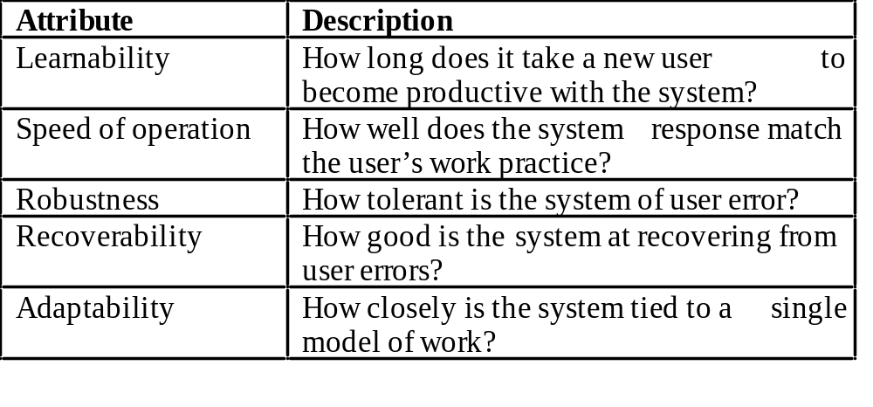
Usability attributes

Slide 77
Simple evaluation techniques
Questionnaires for user feedback
Video recording of system use and subsequent
tape evaluation.
Instrumentation of code to collect information
about facility use and user errors.
The provision of a grip button for on-line user
feedback.

Slide 78
Textbook sources
Pressman, R. S. (2020). Software engineering: A practitioner’s approach (9th ed.). McGraw Hill.
Sommerville, I. (2021). Software engineering (10th ed.). Pearson Addison Wesley.

Slide 79
Key points
Interface design should be user-centred. An interface should be logical and consistent and help users recover from errors
Interaction styles include direct manipulation, menu systems form fill-in, command languages and natural language
Graphical displays should be used to present trends and approximate values. Digital displays when precision is required
Colour should be used sparingly and consistently

Slide 80
Key points
Systems should provide on-line help. This should include “help, I’m in trouble” and “help, I want information”
Error messages should be positive rather than
negative.
A range of different types of user documents should be provided
Ideally, a user interface should be evaluated against a usability specification

